Slide 1

Data Preprocessing

Slide 2
Data Preprocessing-Outline
Types of data
Data Preprocessing Techniques
Missing data
Noisy data
Outliers
Duplicates

Slide 3
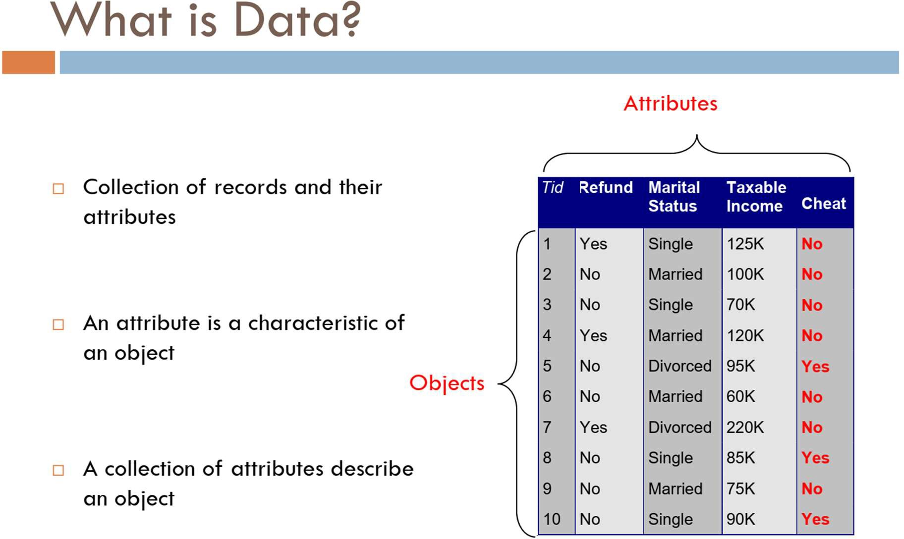

Slide 4
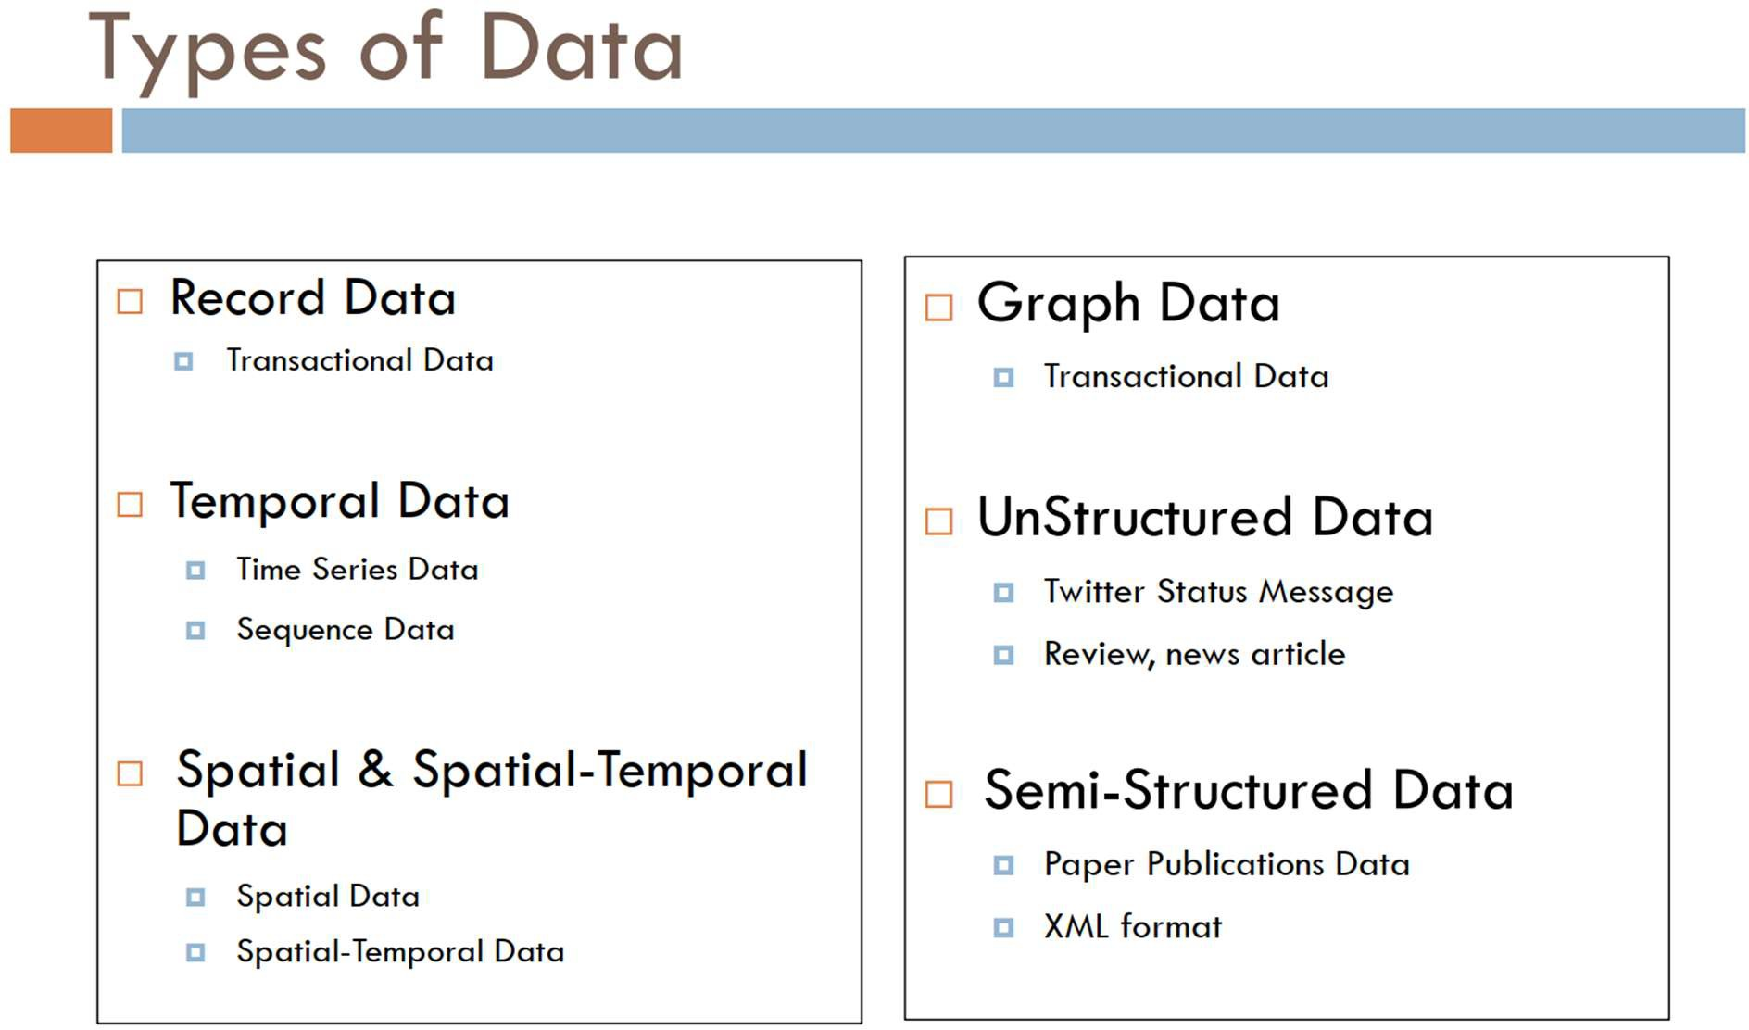

Slide 5
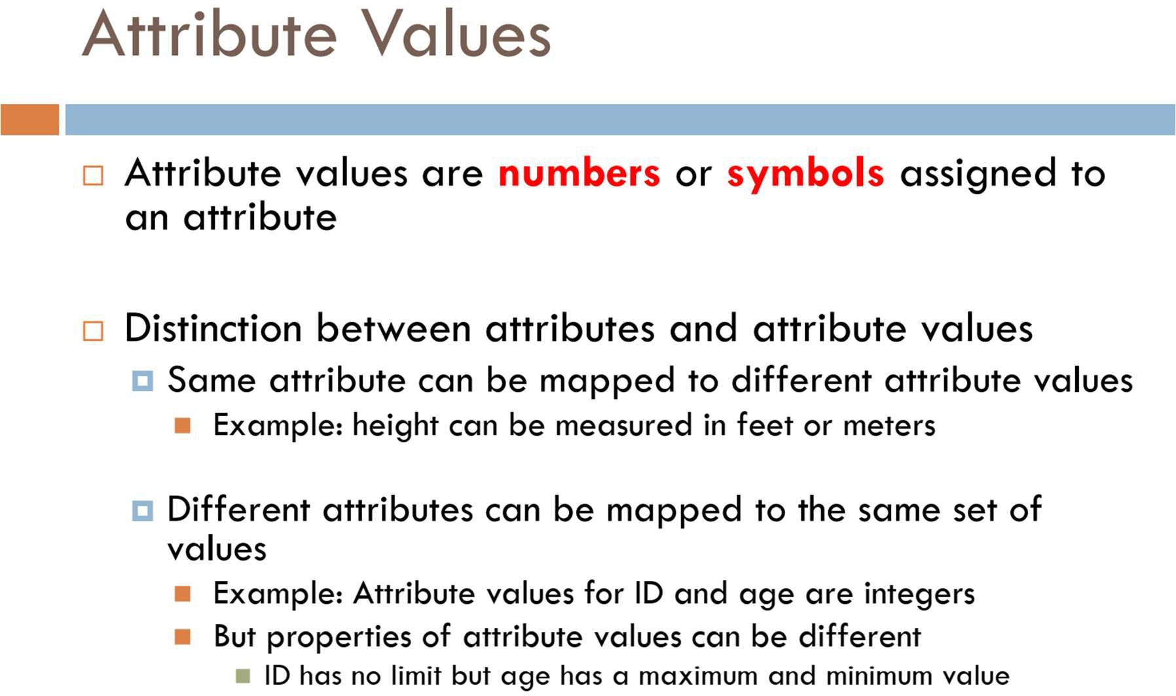

Slide 6
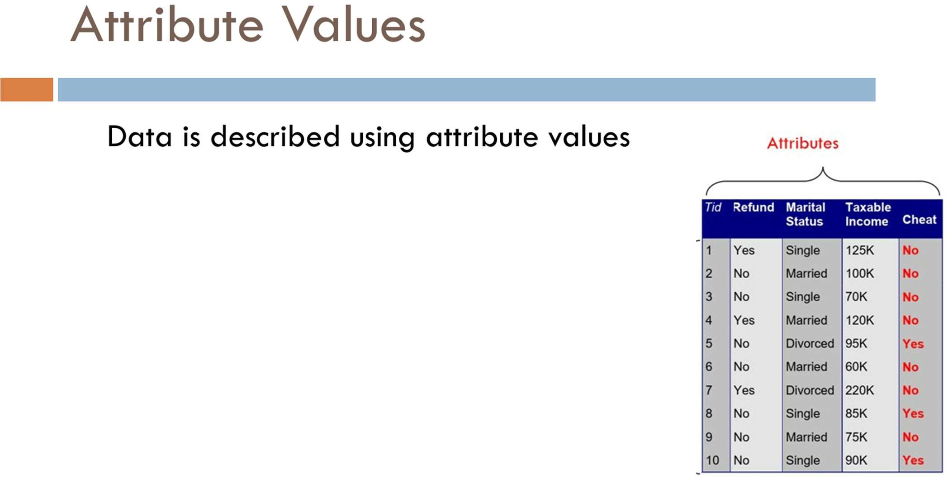

Slide 7
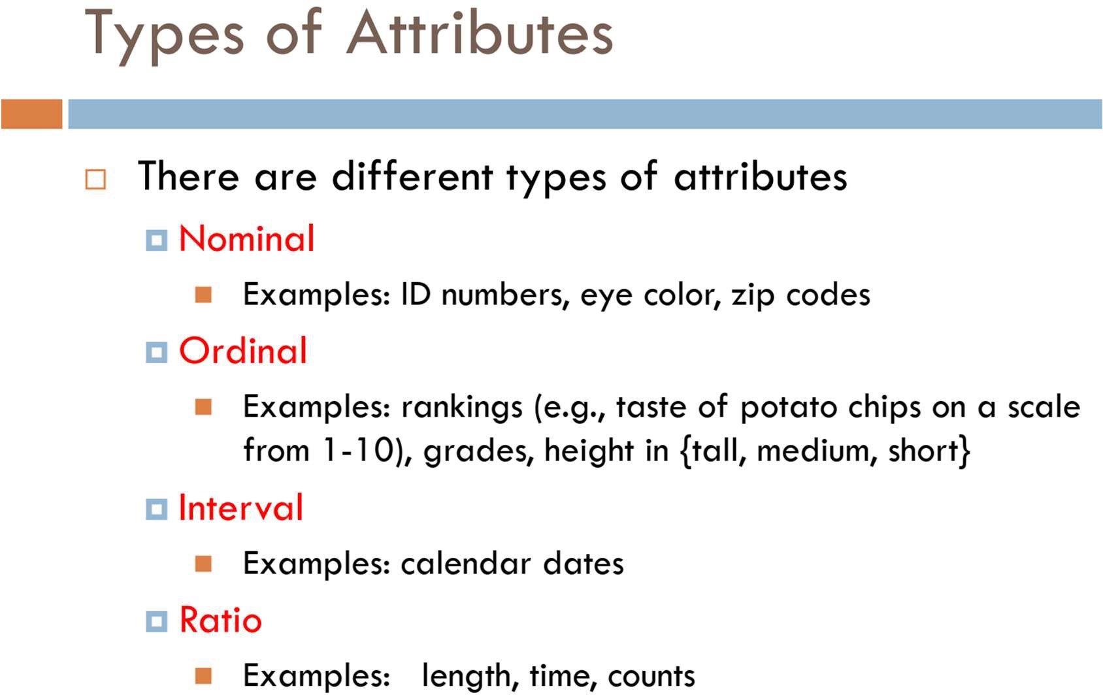

Slide 8
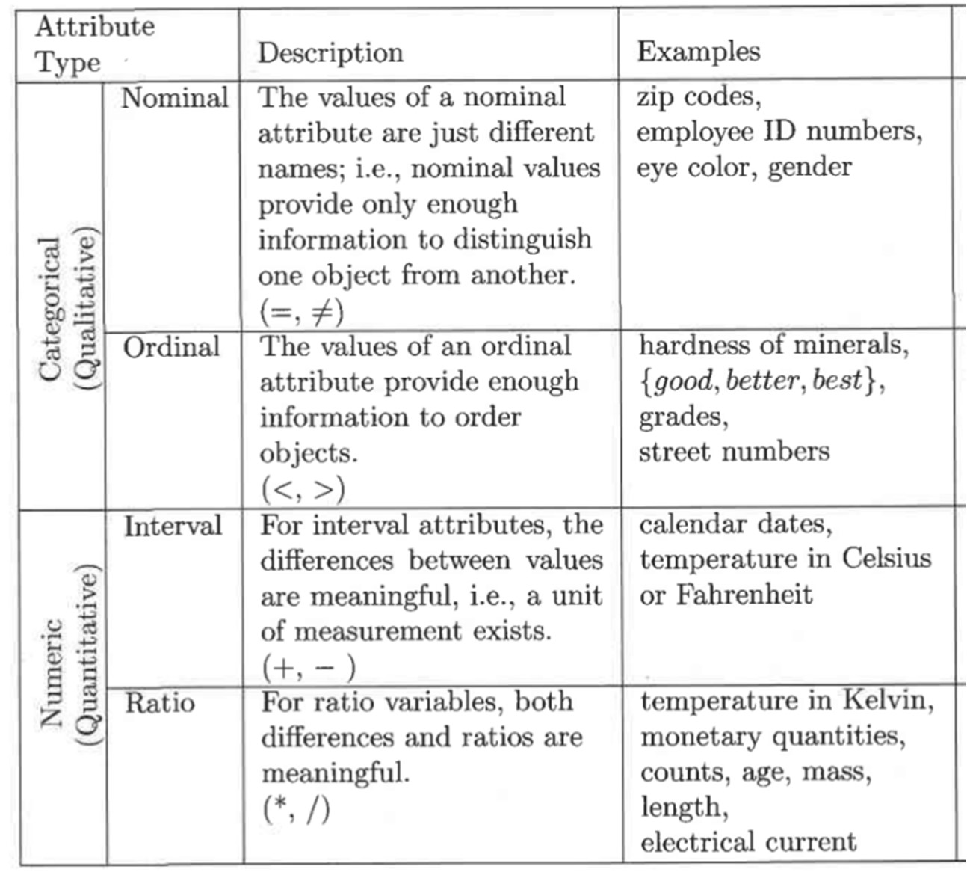

Slide 9
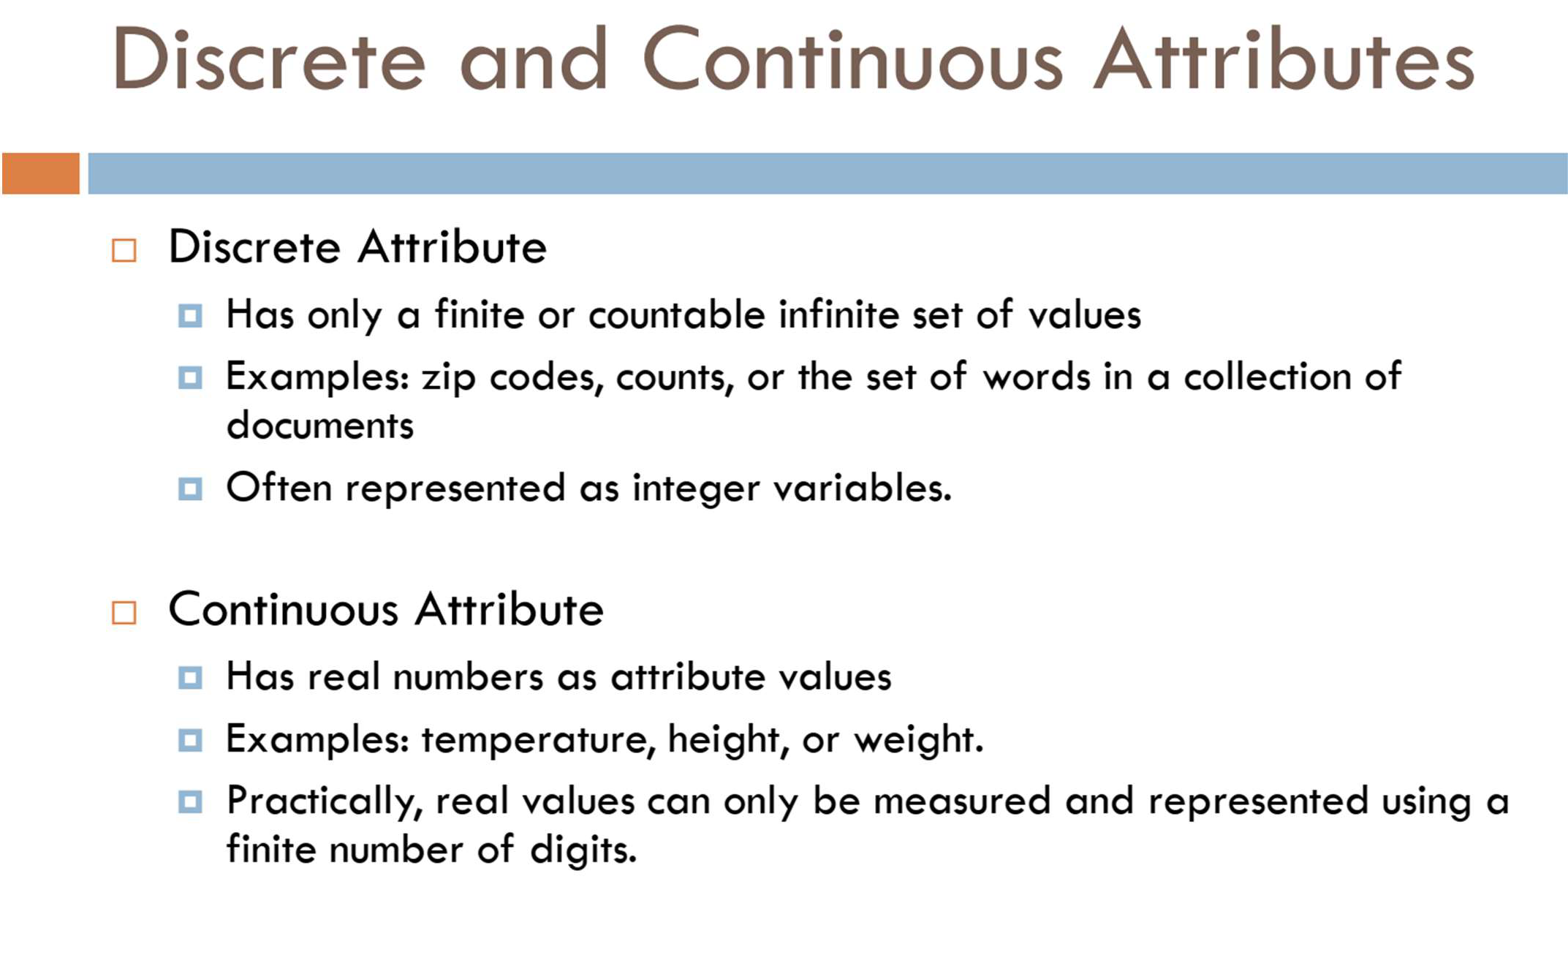

Slide 10
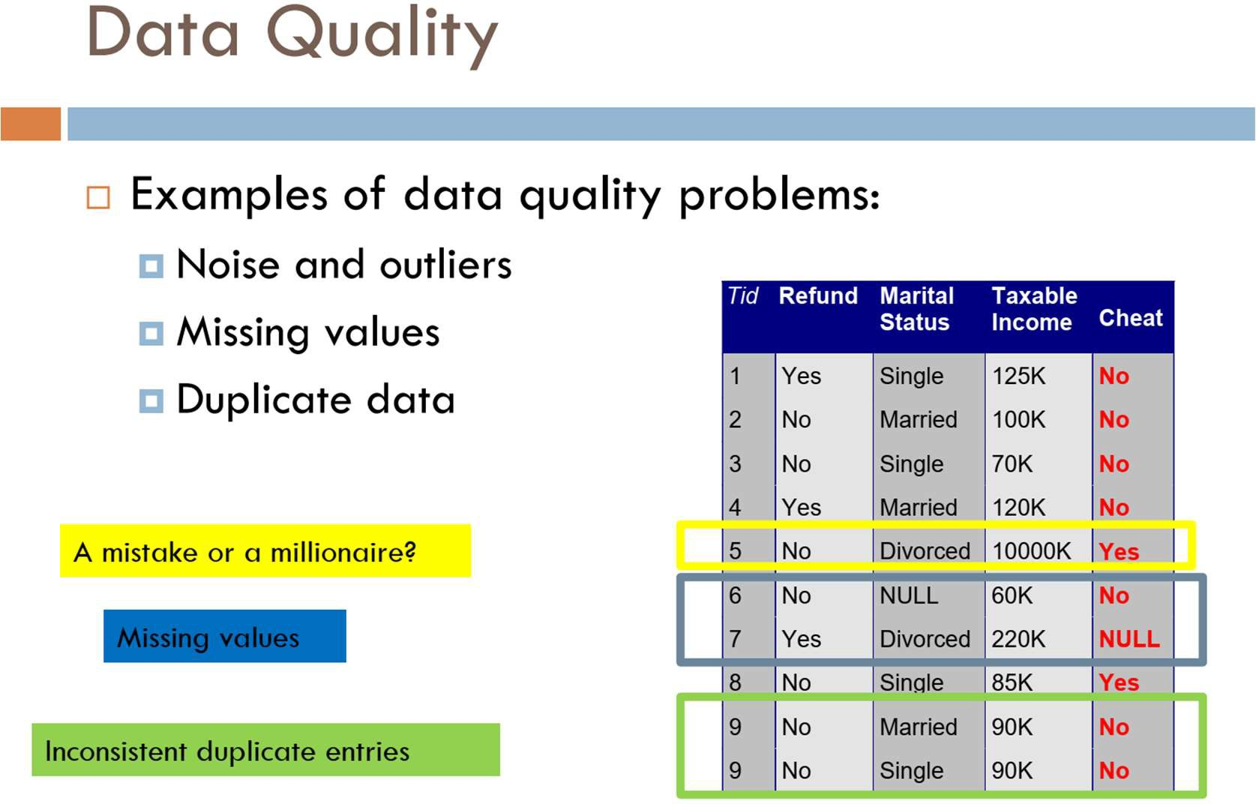

Slide 11
Data Cleaning
Data cleaning tasks
Fill in missing values
Identify outliers and smooth out noisy data
Correct inconsistent data
Resolve redundancy caused by data integration

Slide 12
Noisy Data
Noise: random error or variance in a measured variable.
Incorrect attribute values may be due to
faulty data collection instruments
data entry problems
data transmission problems
etc
Other data problems which require data cleaning
duplicate records, incomplete data, inconsistent data

Slide 13
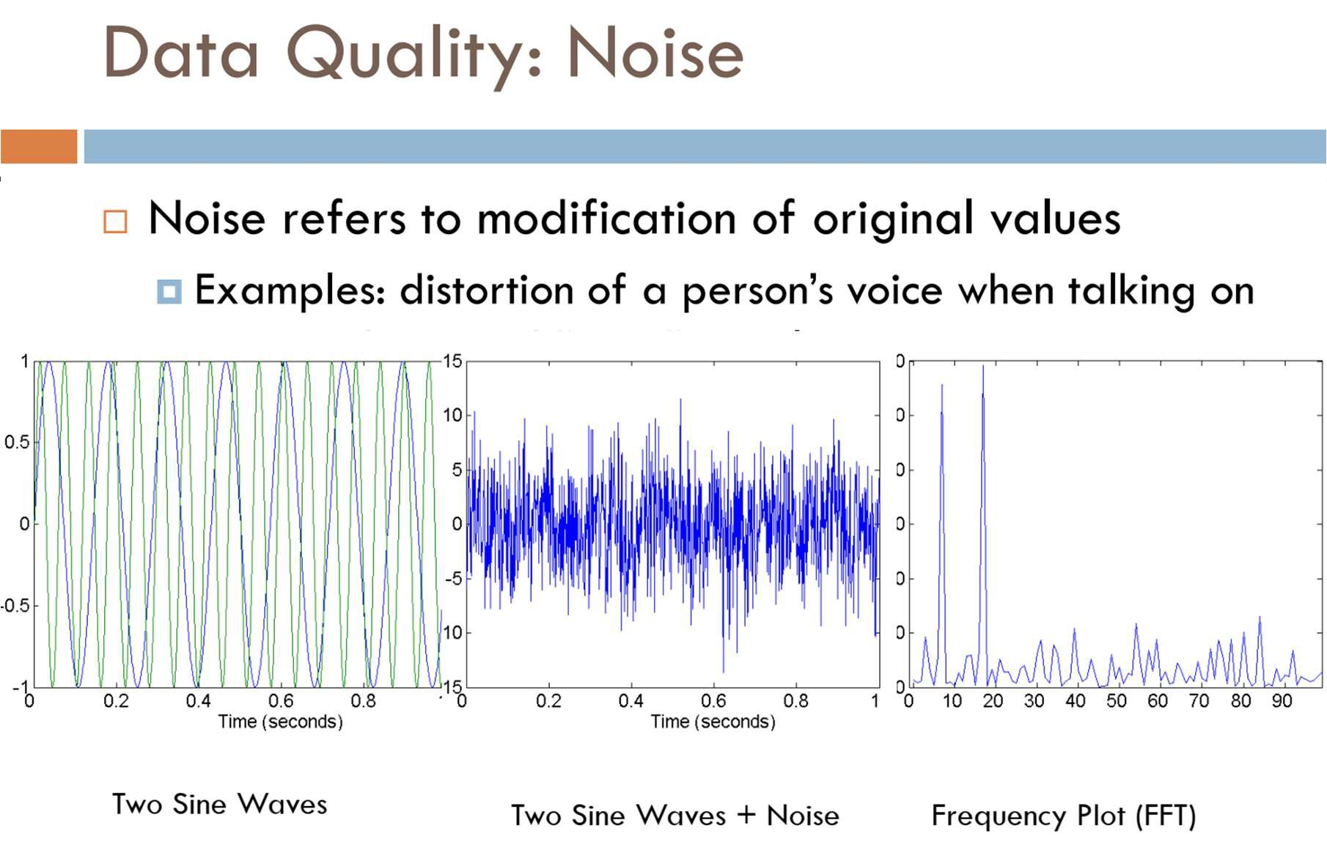

Slide 14
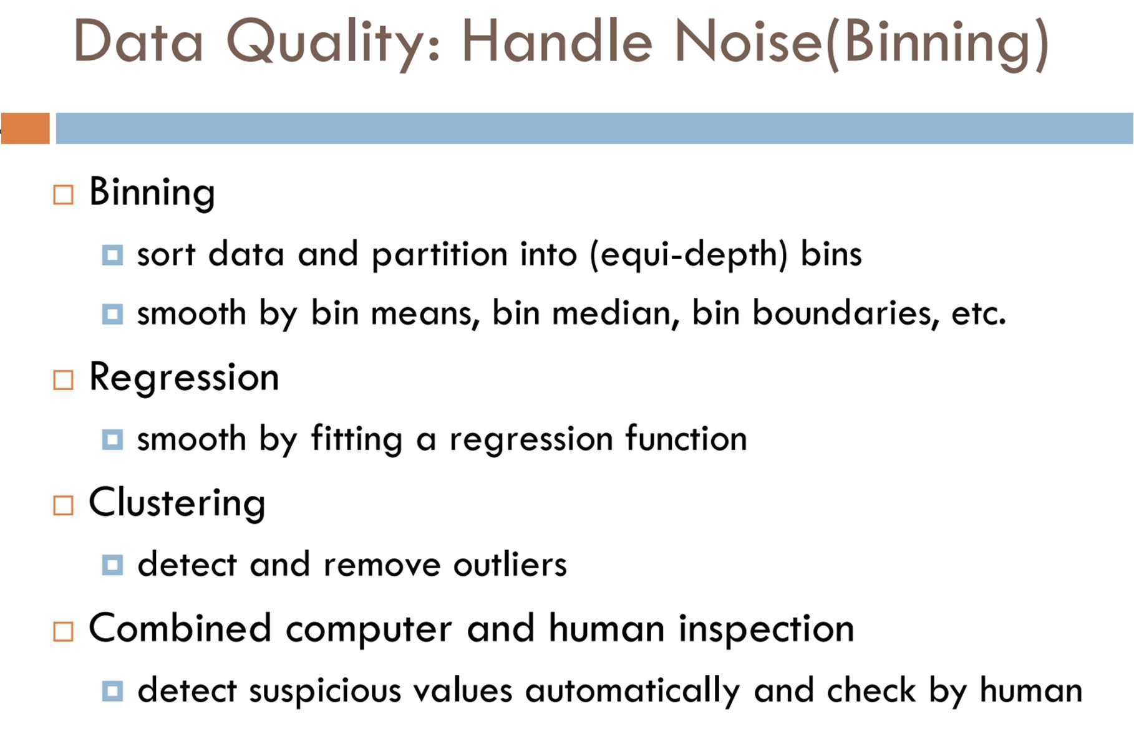

Slide 15
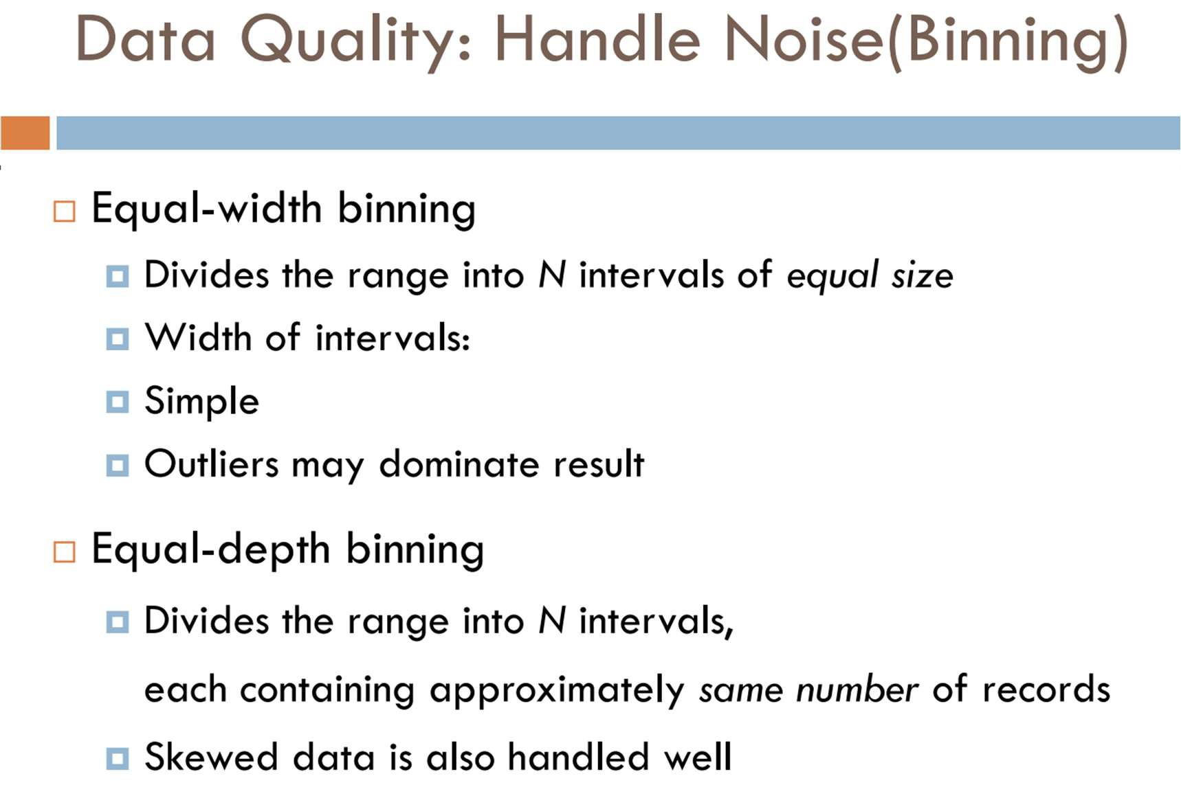

Slide 16
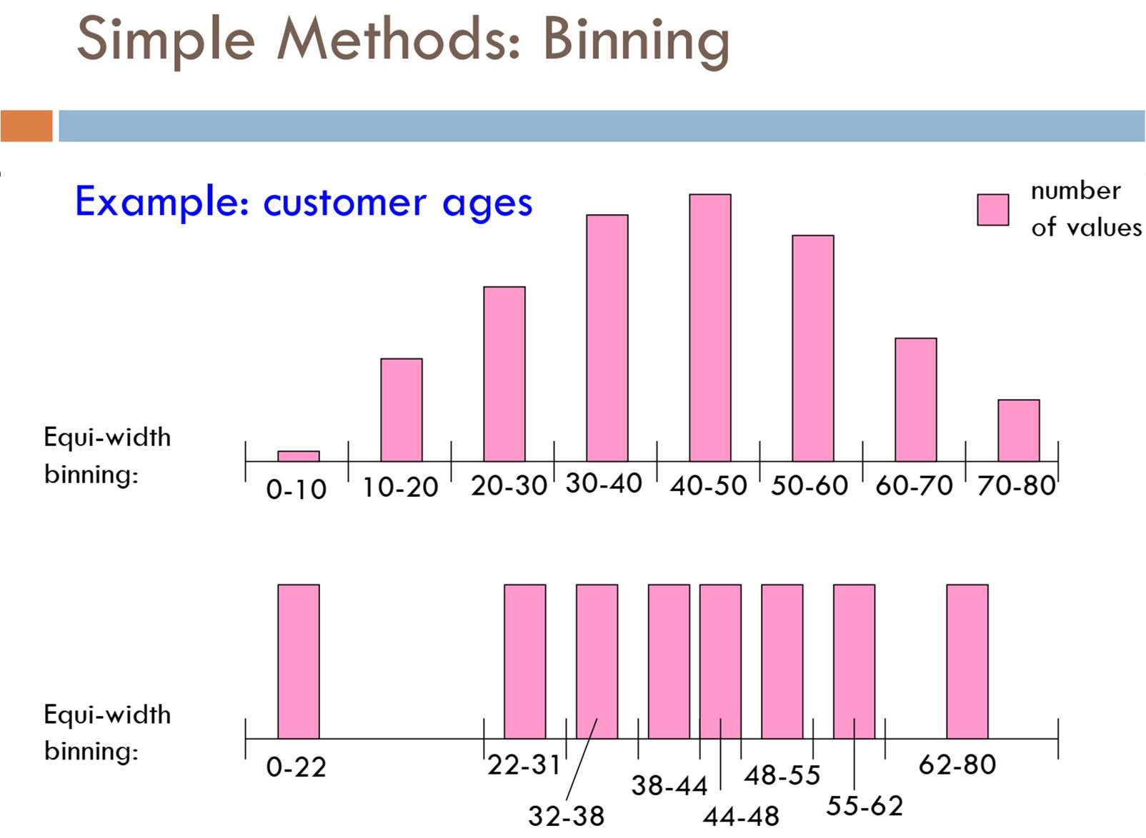

Slide 17
Binning Methods for Data Smoothing
Sorted data for price (in dollars):
4, 8, 9, 15, 21, 21, 24, 25, 26, 28, 29, 34
Partition into (equi-depth) bins:
Bin 1: 4, 8, 9, 15
Bin 2: 21, 21, 24, 25
Bin 3: 26, 28, 29, 34
Smoothing by bin means:
Bin 1: 9, 9, 9, 9
Bin 2: 23, 23, 23, 23
Bin 3: 29, 29, 29, 29
Smoothing by bin boundaries: closest boundary value
Bin 1: 4, 4, 4, 15
Bin 2: 21, 21, 25, 25
Bin 3: 26, 26, 26, 34

Slide 18
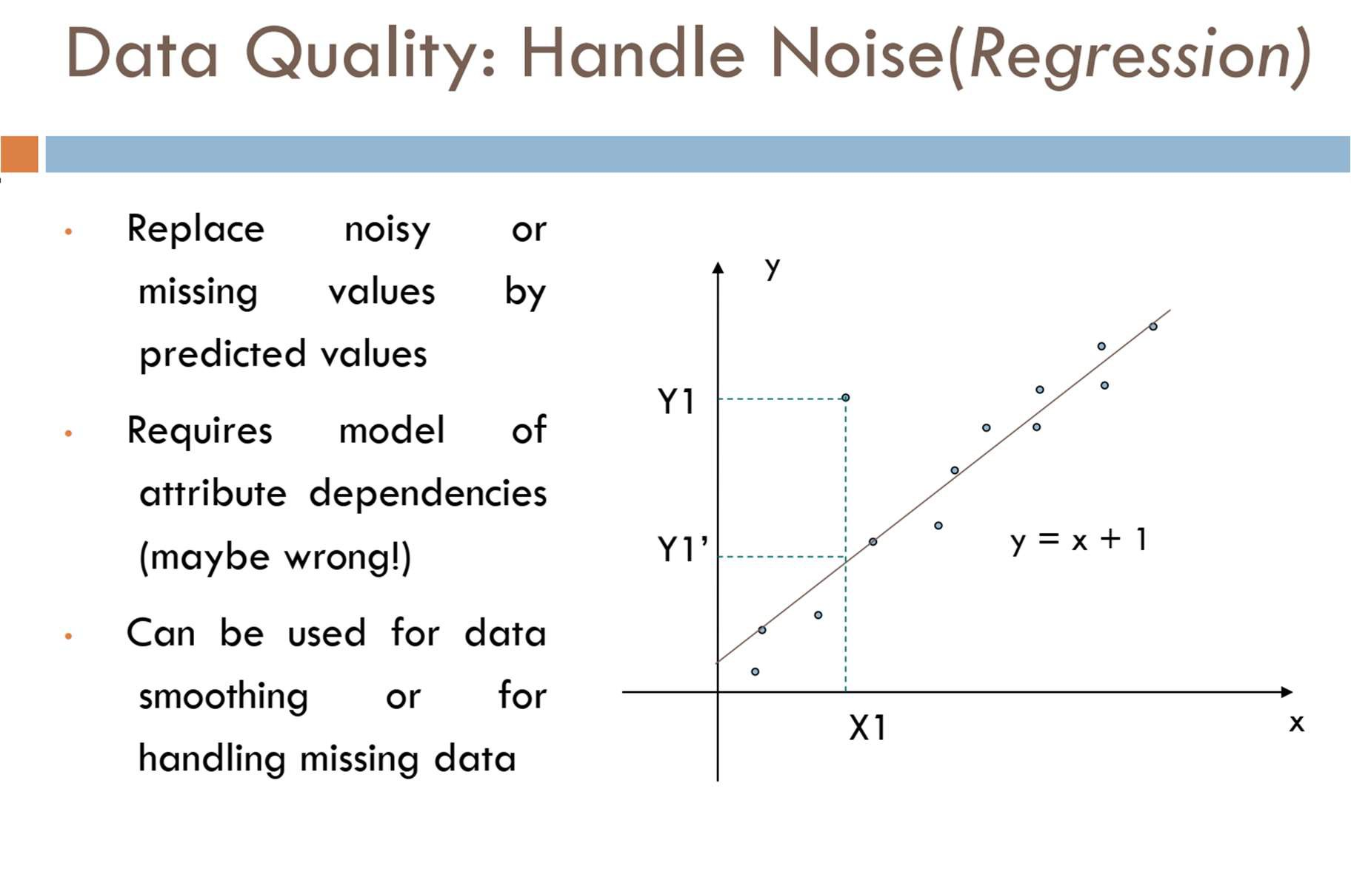

Slide 19
Missing Data
Data is not always available
E.g., many tuples have no recorded values for several attributes, such as customer income in sales data
Missing data may be due to
equipment malfunction
inconsistent with other recorded data and thus deleted
data not entered due to misunderstanding
certain data may not be considered important at the time of entry
not register history or changes of the data

Slide 20
How to Handle Missing Data?
Ignore the tuple
Fill in missing values manually: tedious + infeasible?
Fill in it automatically with
a global constant: e.g., “unknown”, a new class?!
the attribute mean
the most probable value: inference-based such as Bayesian formula, decision tree, or EM algorithm

Slide 21
https://www.datacamp.com/tutorial/techniques-to-handle-missing-data-values

Slide 22
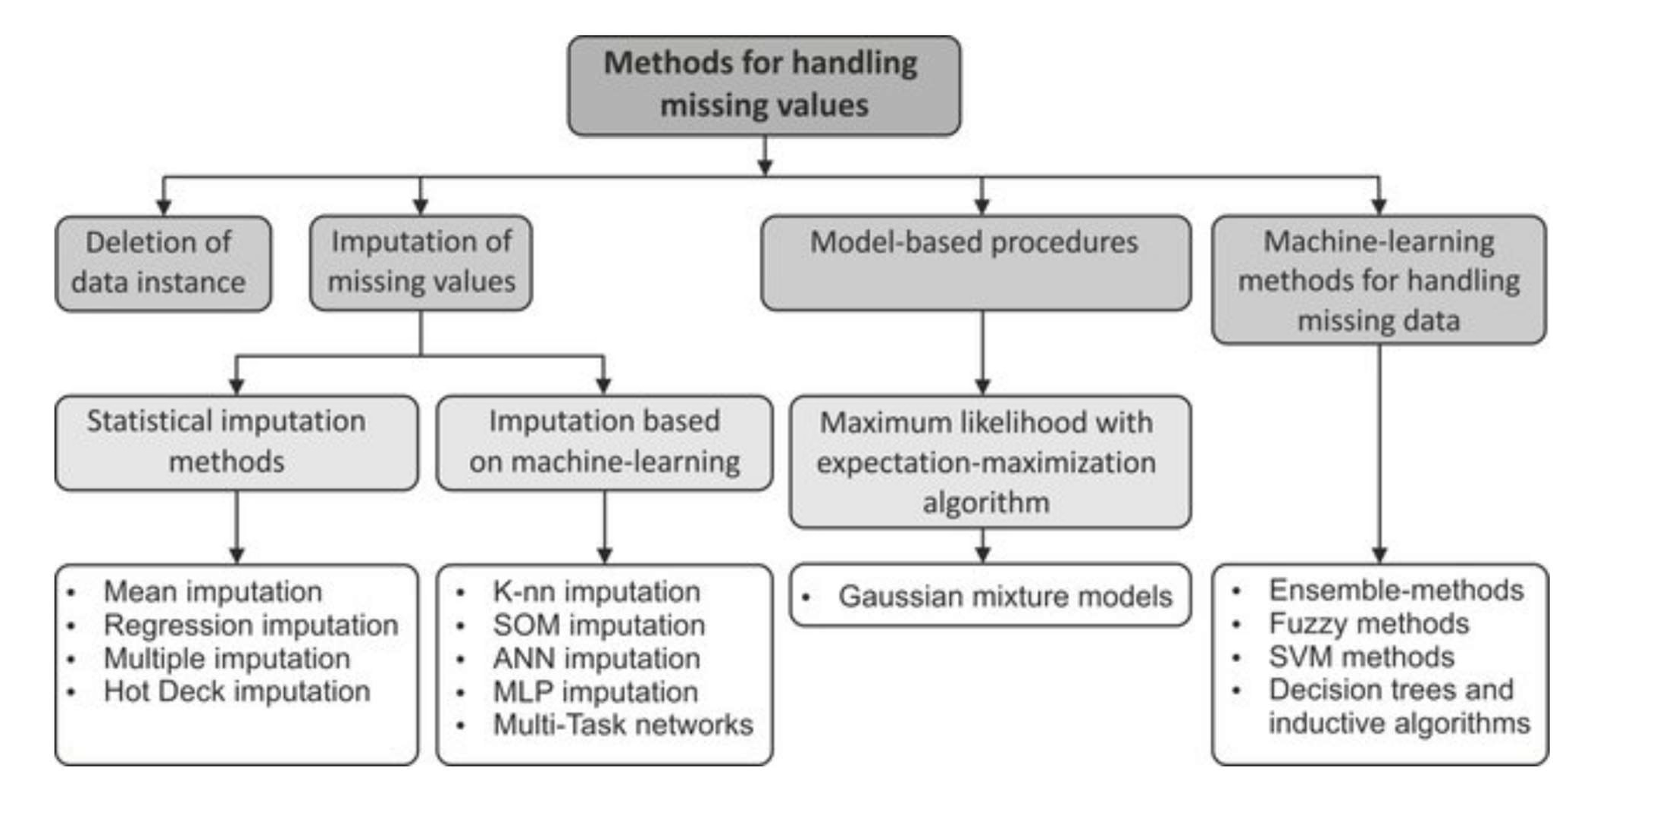

Slide 23
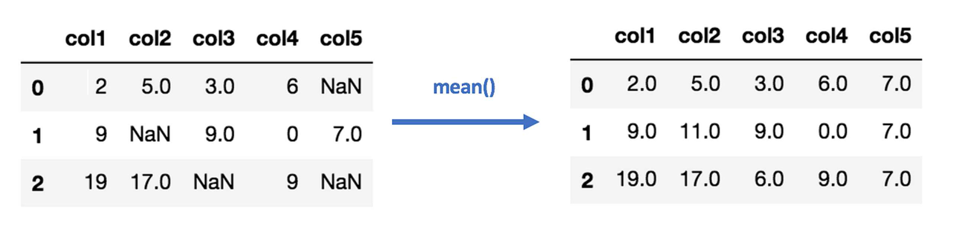
Mean Imputation
Mean, median, mode imputation

Slide 24
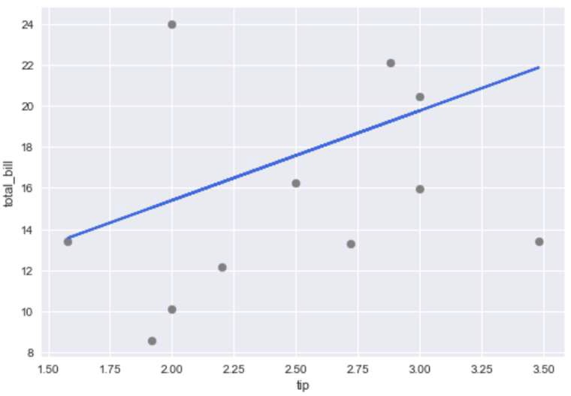
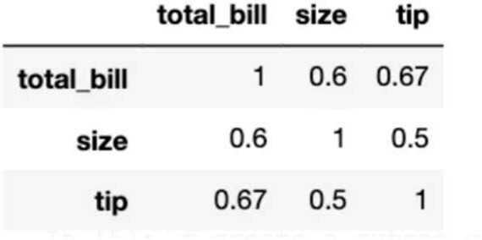
Regression Imputation
If we know there is a correlation between the missing value and other variables, we can often get better guesses by regressing the missing variable on other variables.
we can use a simple linear model regressing total_bill on tip to fill the missing values in total_bill

Slide 25
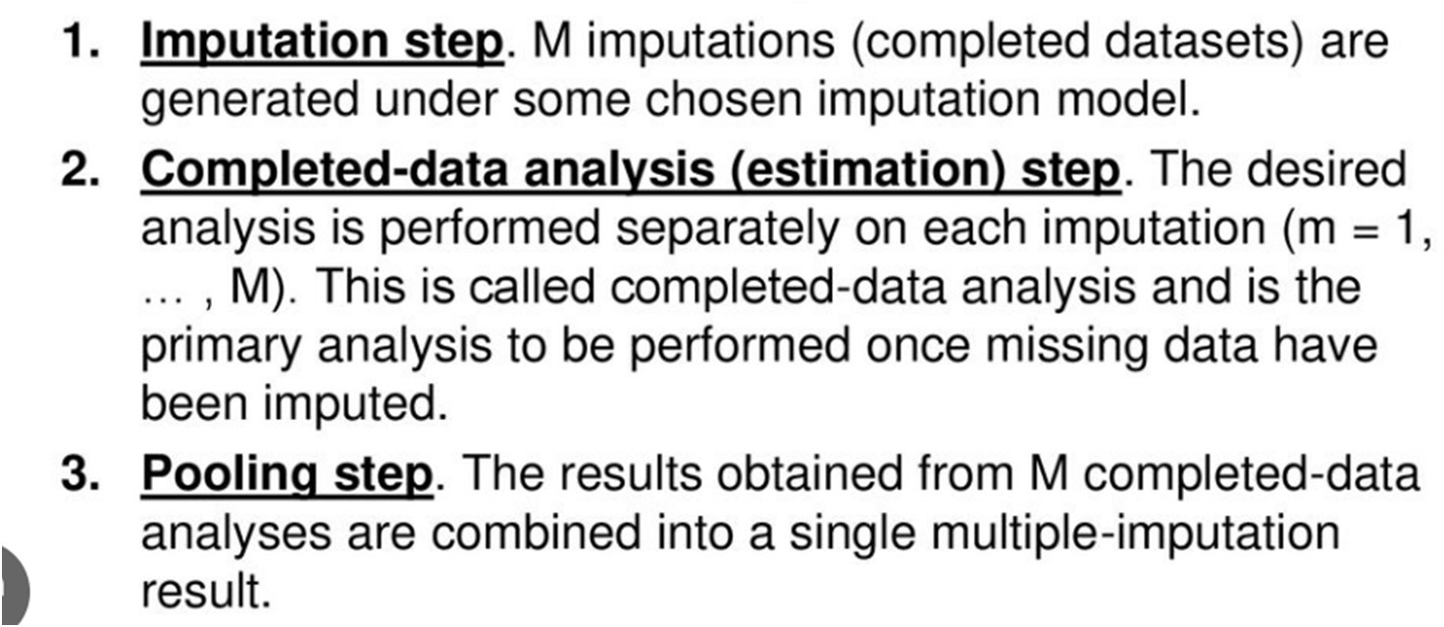
Multiple Imputation

Slide 26
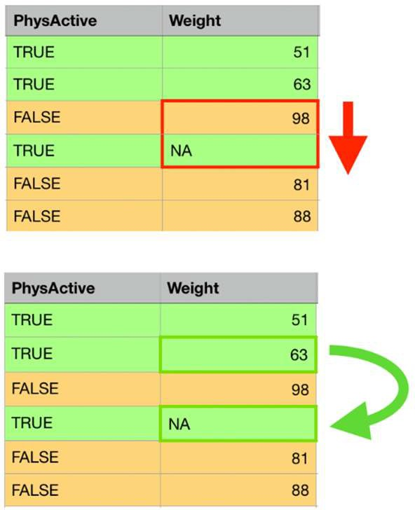
Hot deck imputation
each missing value is replaced with an observed response from a "similar" unit

Slide 27
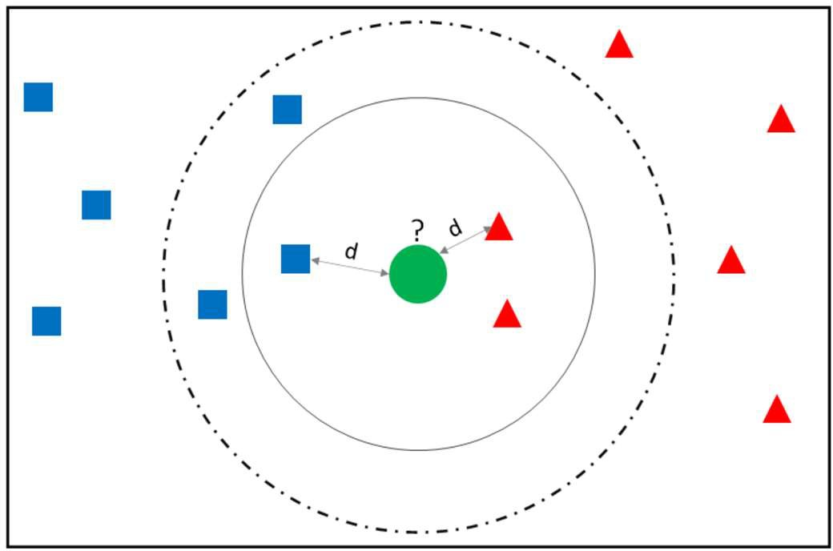
K-NN imputation
use 'k' samples to estimate the value of the missing data points. Each sample's missing values are imputed using the mean value of the 'k'-neighbors found in the dataset.

Slide 28
Outliers
Types of Outliers
Methods to find outliers
Box plots
IQR method
Z-score method
K-nn-based method
LOF
Clustering

Slide 29
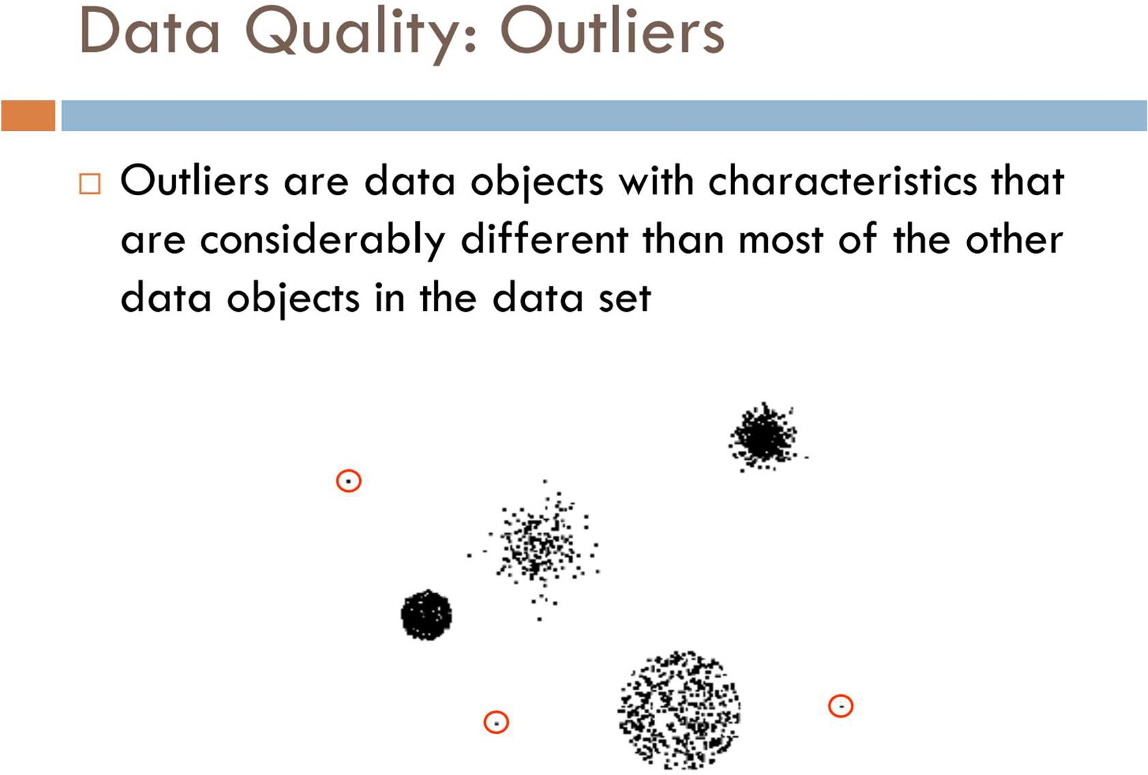
https://towardsdatascience.com/outlier-detection-methods-in- machine-learning-1c8b7cca6cb8

Slide 30
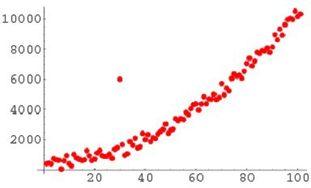
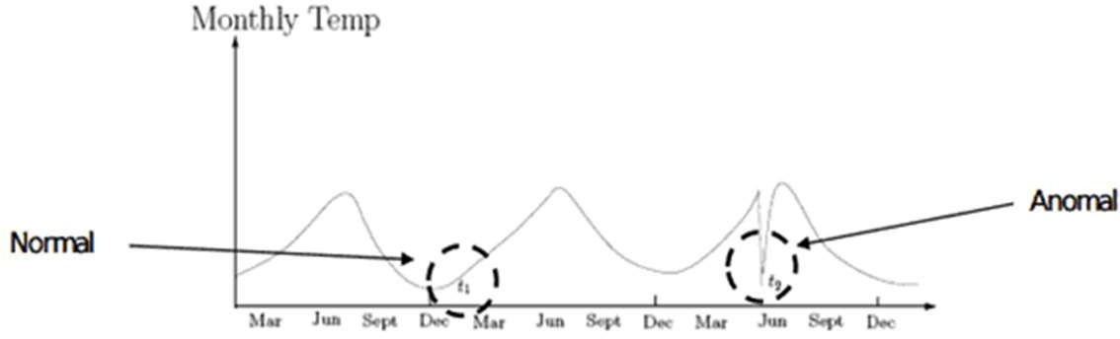
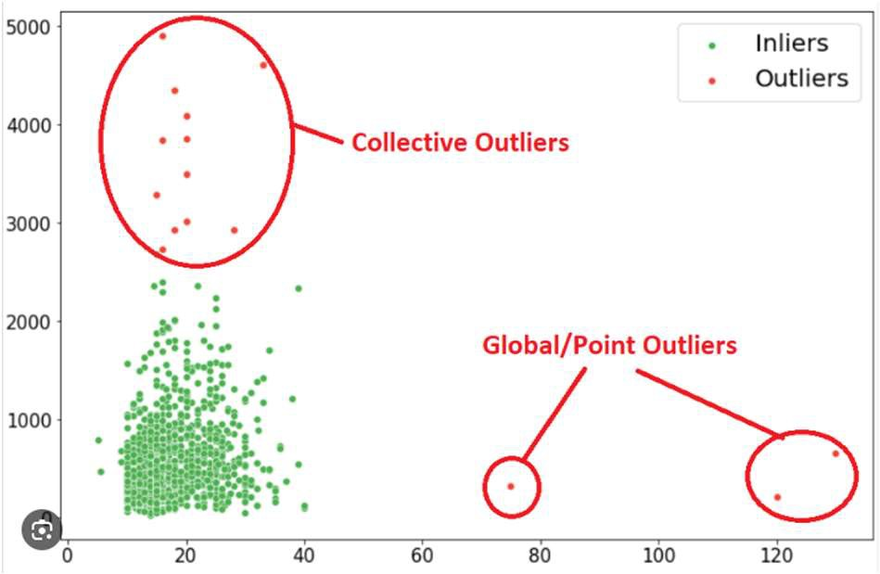
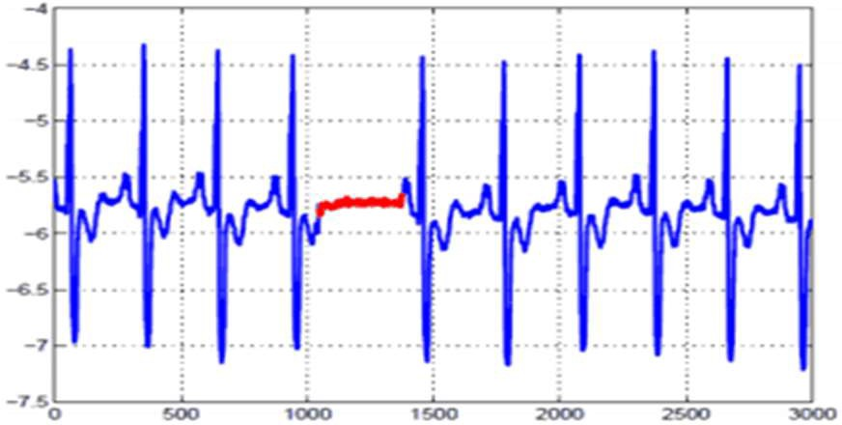
Types of Outliers
Type 1 – Global - “Point Anomalies,” are kind of outliers which deviate significantly from the rest of the data.
Type 2 – Contextual - anomalous in a specific context or condition (but not otherwise)
Type 3 – Collective- collection of data points is anomalous with respect to the entire data set

Slide 31
Outliers are different from the noise data.
Noise is a random error or variance in a measured variable
Noise should be removed before outlier detection An outlier may indicate an experimental error, or it may be due to variability in the measurement.

Slide 32
Methods to identify outliers in the data
Box plots
IQR method
Z-score method
knn
LOF
Clustering

Slide 33
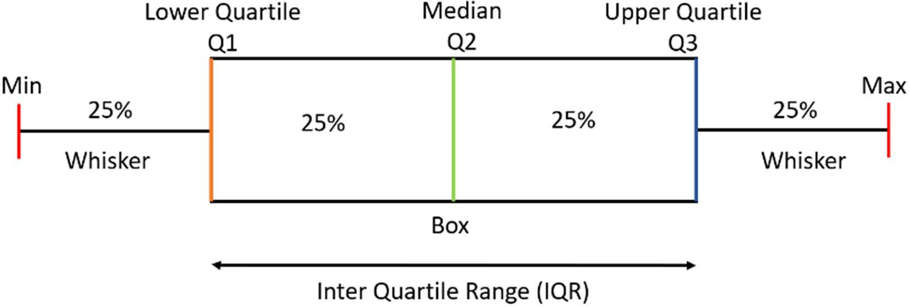
Understanding Boxplots
IQR = Q3-Q1
Lower Limit = Q1 - 1.5*IQR
Upper Limit = Q3 + 1.5*IQR
Outliers are the data points below and above the lower and upper limit.
Minimum – It is the minimum value in the dataset excluding the outliers
First Quartile (Q1) – 25% of the data lies below the First (lower) Quartile.
Median (Q2) – It is the mid-point of the dataset. Half of the values lie below it and half above.
Third Quartile (Q3) – 75% of the data lies below the Third (Upper) Quartile.
Maximum – It is the maximum value in the dataset excluding the outliers.

Slide 34
Quartile Computation Example
▪ 100,110,110,110,120,120,130,140,140,150,170,220
▪ Median (Q2) = (120+130)/2 = 125 ;
▪ First Quartile - take the first six values and find their median.
▪
▪
100,110,110,110,120,120,130,140,140,150,170,220
Q1 = (110+110)/2 = 110
▪ Third Quartile, take the next six and find their median.
▪
▪
100,110,110,110,120,120,130,140,140,150,170,220
Q3 = (140+150)/2 = 145
▪ If the total number of values is odd then we exclude the Median while calculating Q1 and Q3.
▪ IQR = Q3-Q1 = 145-110 = 35
▪ Lower Limit = Q1-1.5*IQR = 110-1.5*35 = 57.5
▪ Upper Limit = Q3+1.5*IQR = 145+1.5*35 = 197.5
▪ Minimum = 100
▪ Maximum = 170
▪ The outliers which are outside this range are –
▪ Outliers = 220

Slide 35
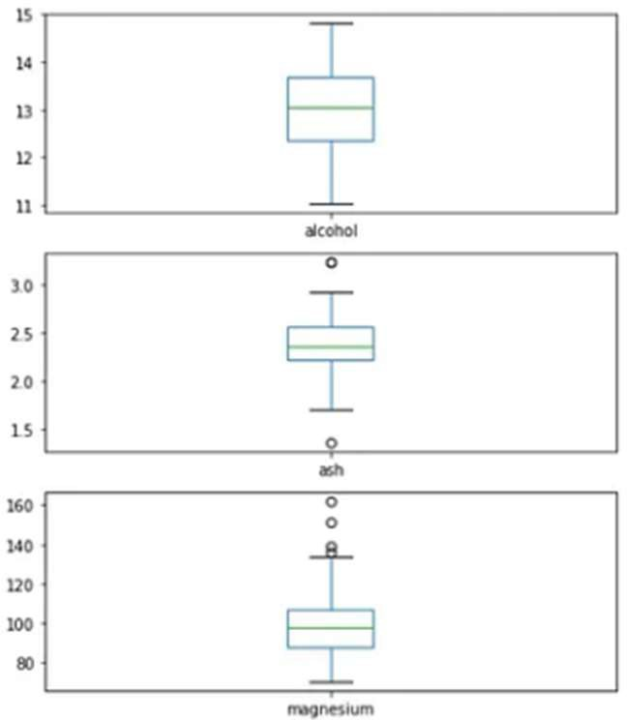
1. Box plots
Box plots visualize data distribution.
plots the q1 (25th percentile), q2 (50th percentile or median) and q3 (75th percentile)
(q1–1.5*(q3-q1)) and (q3+1.5*(q3-q1)).
Outliers, if any, are plotted as points above and below the plot.

Slide 36
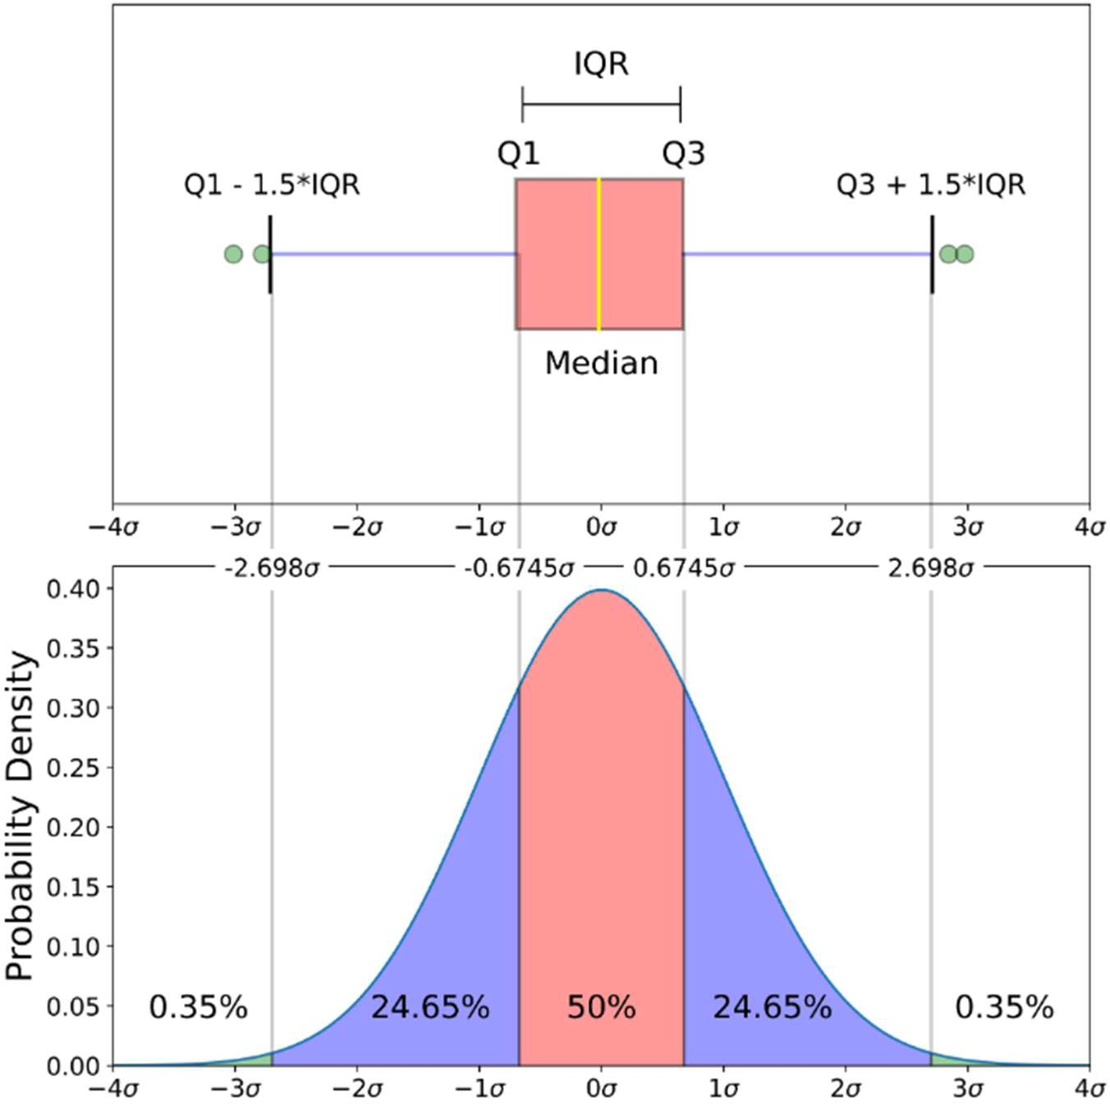

Slide 37
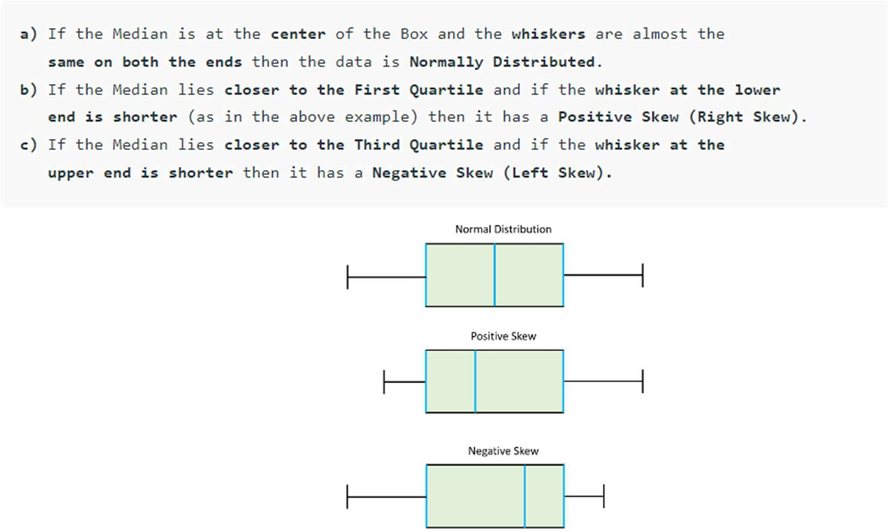

Slide 38
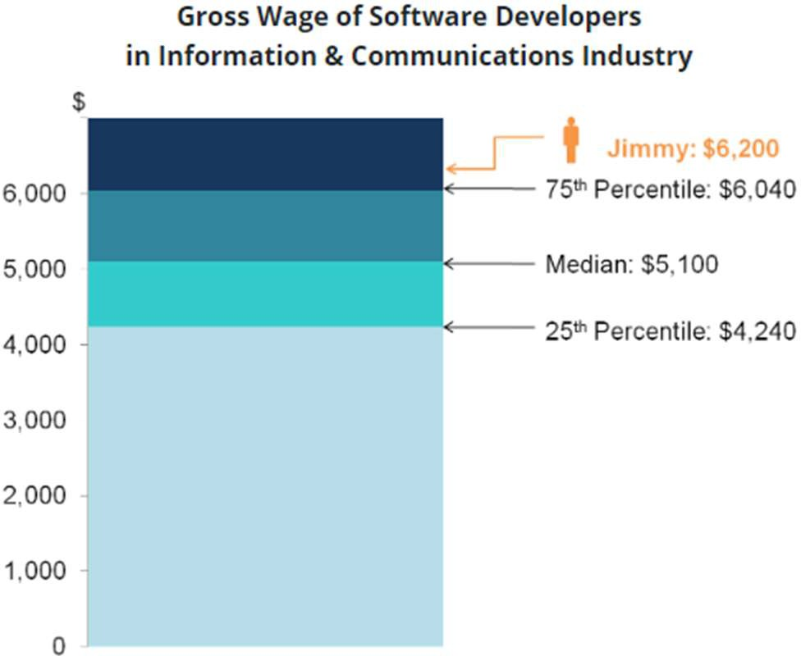
How a score compares to other scores in the same set?
Quartile Uses
Suppose Jimmy works as a software developer He earns a monthly gross wage of $6,200. He would like to find out how his wages compare with those working in the same occupation and industry.
He obtained data on the 25th percentile, median and 75th percentile wage levels
Jimmy’s wage is above the 75th percentile, he is among the top 25% of earners among software developers in the industry.
The 25th percentile is the value at which 25% of data lie below that value, and 75% of data lie above that value.
50th Percentile - Also known as the Median. The median cuts the data set in half. Half of the data lie below the median and half lie above the median.
75th Percentile - third, or upper, quartile. - value at which 25% of the data lie above that value and 75% of the answers lie below that value.
•

Slide 39
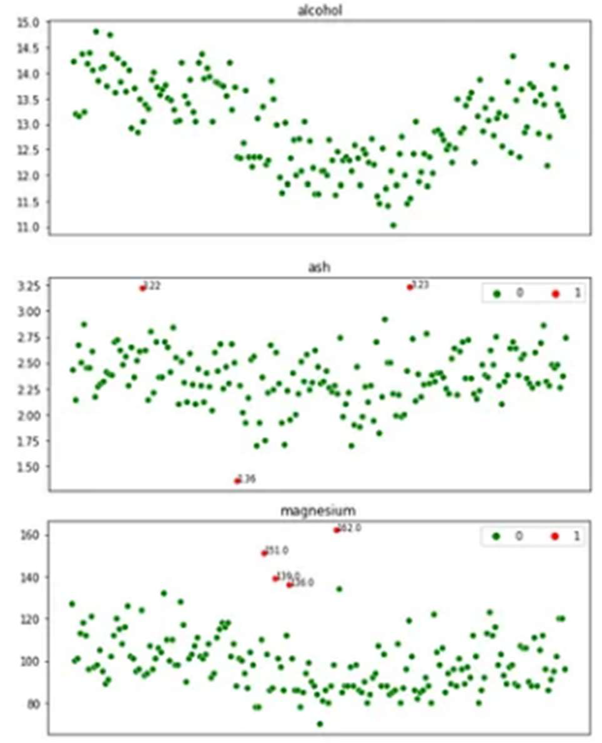
2. IQR method
Lower Bound = q1–1.5*IQR
Upper Bound = q3+1.5*IQR
Any value below the lower bound and above the upper bound are considered to be outliers.

Slide 40
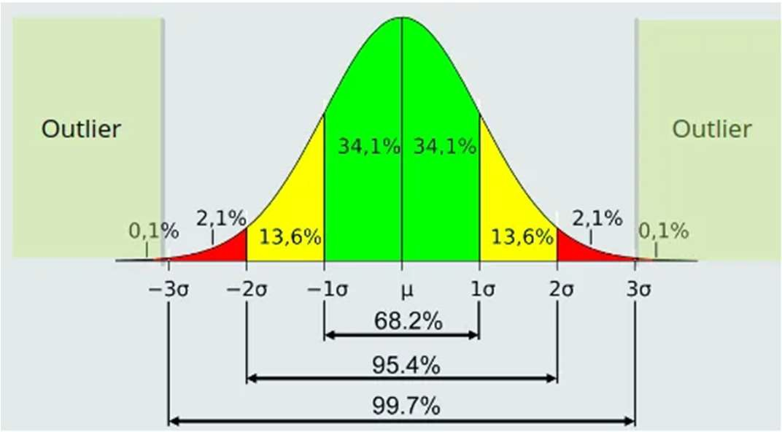
3. Z-score method
Z-score is the number of standard deviations a value of a variable is away from the variable’ mean.
Z-Score = (X-mean) / Standard deviation
Example:
weights of newborns are normally distributed with a mean of about 7.5 pounds and a standard deviation of 0.5 pounds. If a certain newborn weights 7.7 pounds, What is the z-score?
z = (x – μ) / σ
z = (7.7 – 7.5) / 0.5
z = 0.4
If x = 10 pounds?

Slide 41
Summary – Data Preprocessing
Missing Data
Noisy Data
Outliers

